Slide 1
Retail Internet Banking
By Rajat Singh Kalra

Slide 2
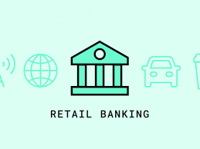
A new age Incarta Development bank is planning to launch its mobile banking application. The bank plans to provide banking, home loans, Credit cards and mutual funds functions through this platform. The details of the project are provided in the document.
Create the context diagram for entire project
Identify and create user stories for the banking module
Create user story cards for any 3 user stories

Slide 3
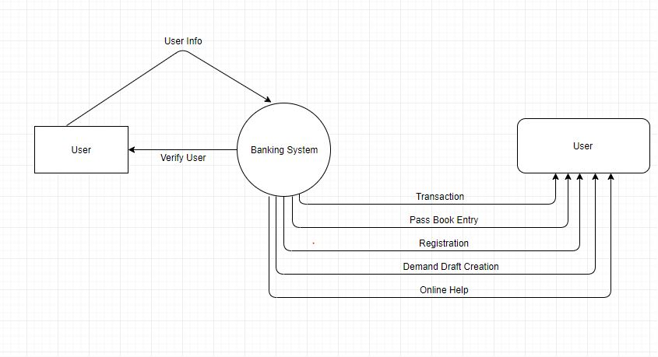
Context Diagram

Slide 4
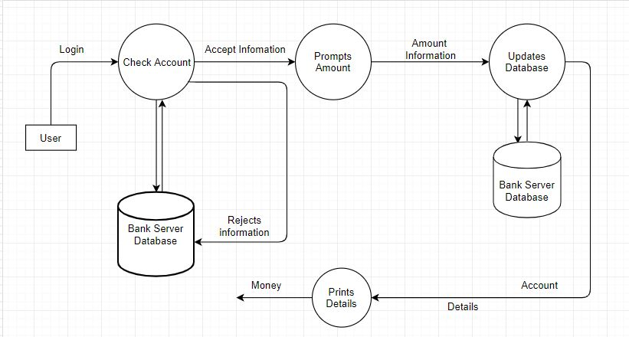

Slide 5
User Stories
As a Customer, he /she can login as a new customer / Add a new account
As a Customer, he/she can view his account summary.
As a Customer, he/she can register payee to transfer funds.
As a Customer, he/she can change password
As a Customer, he/she can update their profile details
As a User, he/she can request a new password of forgot password.
As a Customer, he/she can download their passbook in excel format.
As a Customer, he/she can search their transaction history via Start Date and End Date.

Slide 6
User Story – Story cards
USER STORY 1:
As a Customer, he /she can login as a new customer / Add a new account
Customer applies for the bank account.
Bank employee fills in details on the basis of application form in the system
Business related validations take place as a part of process in the system
New Customer account gets created for the registered Customer automatically
System generates random one time use password which is sent to user by post on the registered address for first login

Slide 7
USER STORY 2:
As a Customer, he/she can register payee to transfer funds.
Register payee flow.
Customer has payee account to be registered.
Customer Add payee account and system does business validations to validate payee account and authenticate user for system security
Payee gets added to Customer payee list.
Customer can have multiple payees.

Slide 8
USER STORY 3:
As a User, he/she can request a new password of forgot password.
User clicks on forgot password link available on login page.
User has to put id and registered mobile, email correctly for authentication.
System locks user account for any activity.
User calls customer care for further assistance as instructed on change password screen.
Bank employee changes user status to Inactive and system will generate random password for one time use.
The one time password will be sent to user on registered Email Id and Phone number.

